Slide 1
50 Years of Music Trends
Are songs becoming more negative or positive? A sentiment analysis of music.

Slide 2
Background
Pop songs reflect pop culture at a specific point in time
Can we “measure” society’s attitude by using Vader Sentiment Analysis on popular songs? And, Is Vader appropriate to analyze music lyrics?
Additionally, are pop songs becoming more positive or negative over time and can we explain those changes using, for example, the economy?
Notes:
Are societal attitudes trending positively or negatively?

Slide 3
Hypothesis
Research Claim: Within the Top 100 Billboard, song lyrics have positively or negatively changed over time.
Null Hypothesis: Within the Top 100 Billboard, song lyrics have not changed over time
Alternate Hypothesis: Within the Top 100 Billboard, song lyrics have significantly changed over time.

Slide 4
Dataset
Our Dataset is comprised of randomly selected weeks using Billboard top 100, for every year from 1968 till 2017
This data is accessed using https://github.com/guoguo12/billboard-charts, a Python API for downloading Billboard Charts.
To find song lyrics, we used the MusixMatch API.

Slide 5
Dataset Limitations
The Billboard Top 100 starts at 1968 (cannot analyze songs before 1968)
MusixMatch only provides access to 30% of a song’s lyrics (free plan limitation).
MusixMatch only provides 2000 API Calls per day and 500 Lyrics display per day

Slide 6
Vader Sentiment Analysis Examples
Your Momma = analyzer.polarity_scores('your mom is a dog’)
N.W.A. = analyzer.polarity_scores("F*** that shit, 'cause I ain't the one, for a punk mother****er with a badge and a gun, to be beating on, and thrown in jail, We can go toe to toe in the middle of a cell")

Slide 7
Examples Cont’d
Happy = analyzer.polarity_scores("Huh, because I'm happy, Clap along if you feel like a room without a roof, Because I'm happy Clap along if you feel like happiness is the truth, Because I'm happy Clap along if you know what happiness is to you, Because I'm happy Clap along if you feel like that's what you wanna do")
Barney = analyzer.polarity_scores("I love you, you love me, we're a happy family, with a great big hug and a kiss from me to you")

Slide 8
Research Flow
Step 1: For every year between 1968 and 2017, grab Billboard top 100 songs from a randomly selected week.
Step 2: For each year, retrieve lyrics for each song and compute Vader score. Find mean Vader scores for each year.
Step 3: Plot Vader Sentiment Scores for each year.

Slide 9
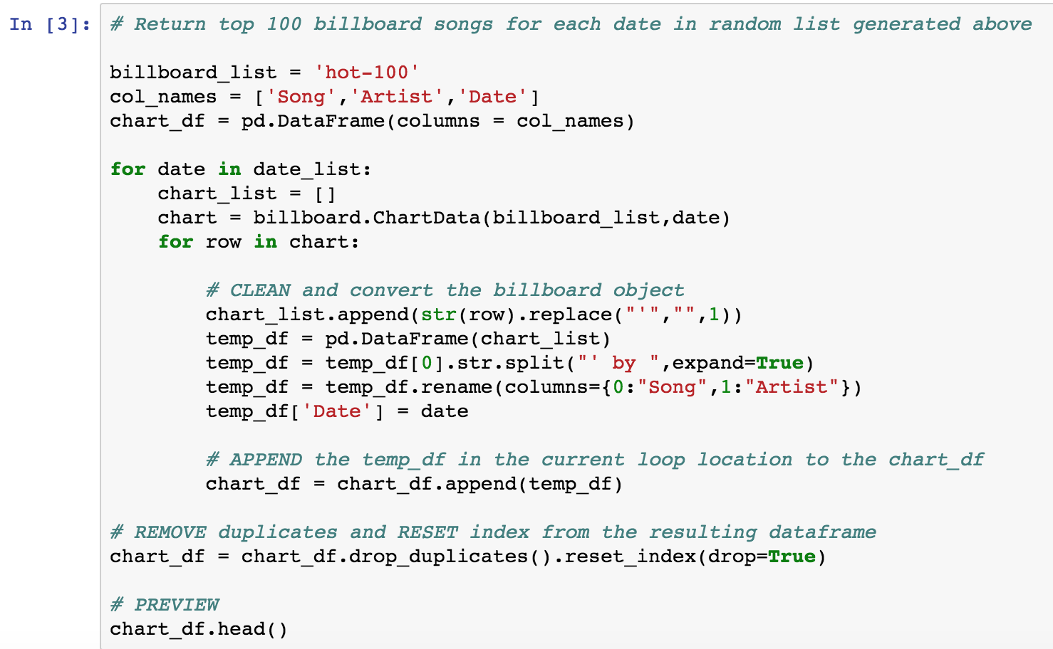
Jupyter Notebook Snippet

Slide 10
Results
Notes:
Sample one graph, 4 lines (positive, negative, neutral, compound)
Sample two graph, 4 lines (positive, negative, neutral, compound)
Sample three graph, 4 lines (positive, negative, neutral, compound)
Negative of all three, and average in one graph
Positive of all three, and average in one graph
Neutral of all three, and average in one graph
Compound of all three, and average in one graph

Slide 11
Reject or Fail to Reject Null Hypothesis?

Slide 12
Discussion and Research Limitations
Business Implications:
What music should artists produce?
What music should be marketed?
Can we accurately filter songs based on Vader (i.e. are they clean or explicit lyrics)?
Can we exploit song lyrics to sell a product or service?
Vader Sentiment Analysis https://github.com/cjhutto/vaderSentiment

Slide 13
Questions?

